Slide 1

AVL Tree
K. Rajesh Rao
Asst. Professor- Senior
Dept. of ICT, MIT

Slide 2
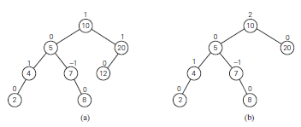
Introduction
Binary Tree
AVL Tree
a) AVL tree. b) Binary search tree that is not an AVL tree

Slide 3
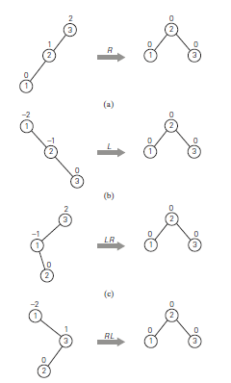
Types of Rotations
Single right rotation (R-rotation)
Single left rotation (L-rotation)
Double left-right rotation (LR-rotation)
Double right-left rotation (RL-rotation)

Slide 4
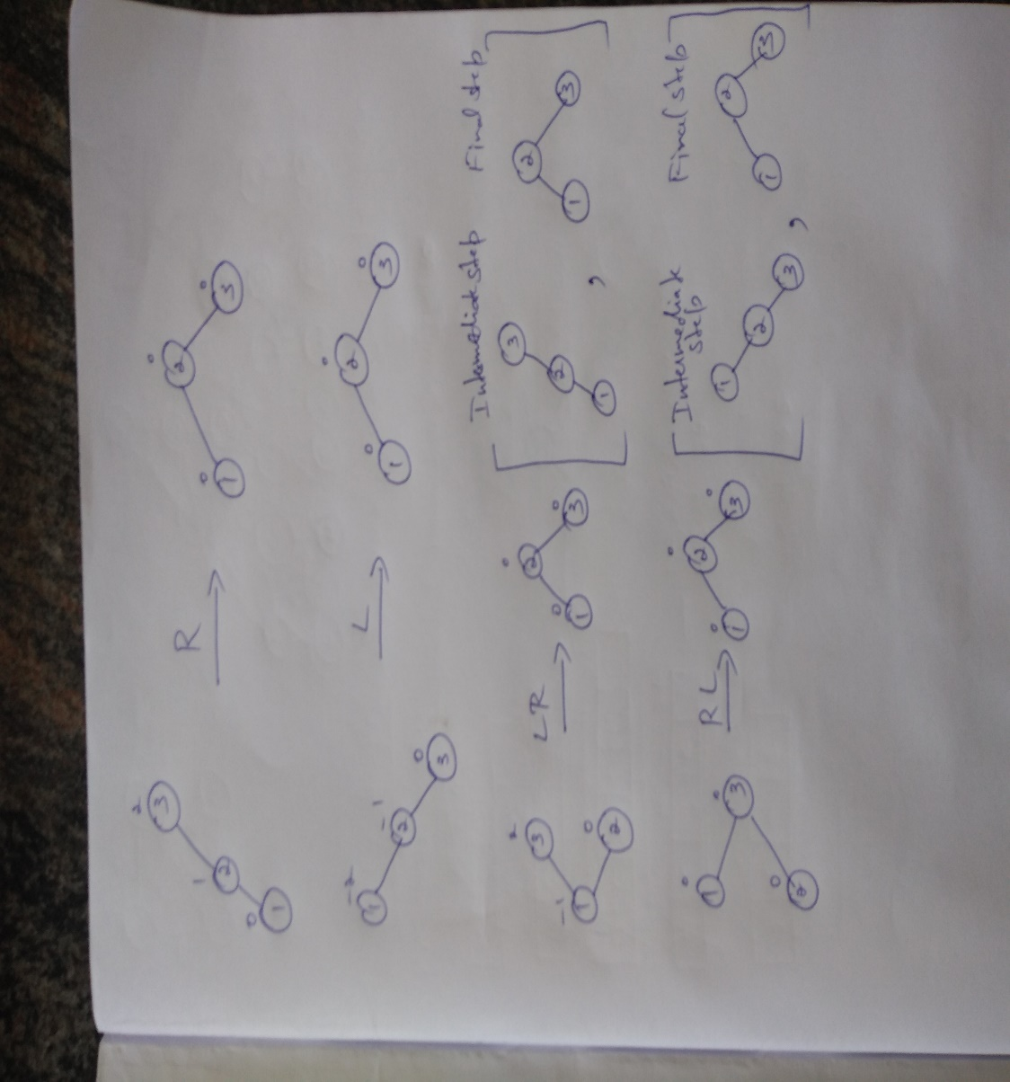
Rotations with intermediate steps

Slide 5
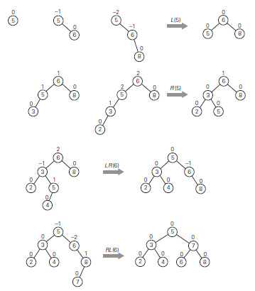
Example on AVL tree
Construction of an AVL tree for the list 5, 6, 8, 3, 2, 4, 7 by successive insertions

Slide 6
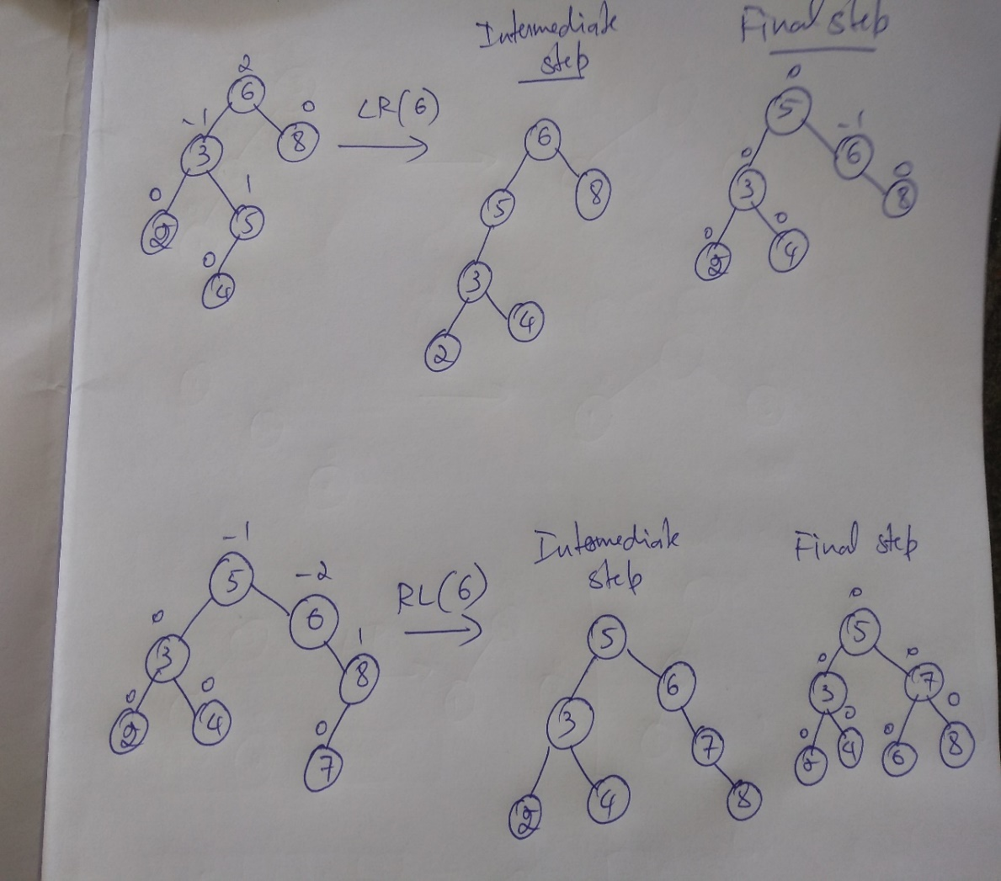
Rotations with intermediate steps

Slide 7
Reference
Introduction to the Design and Analysis of Algorithms, 2nd Edition by Anany Levitin

